Slide 1

Network Science

Slide 2
Which are the most important details so far…?
Basic Definitions
Network (graph): set of elements called nodes
Set of connections between pairs of nodes called links
Two nodes are connected (or adjacent)if there is a link between them
Definition of the Network:
A network G has two parts, a set of N elements, called nodes or vertices, and a set of L pairs of nodes, called links or edges.
The link (i,j) joins the nodes i and j.

Slide 3
Undirected or directed networks
A directed net­work is also called a digraph. In directed networks, links are called directed links and the order of the nodes in a link reflects the direction:
The link (i,j) goes from the source node i to the target node j
In undirected networks, all links are bi-directional and
The order of the two nodes in a link does not matter.
A network can be unweighted or weighted.
In a weighted network, links have associated weights: the weighted link (i,j,w)
between nodes i and j has weight w.
A network can be both directed and weighted, in which case it has directed weighted links.

Slide 4
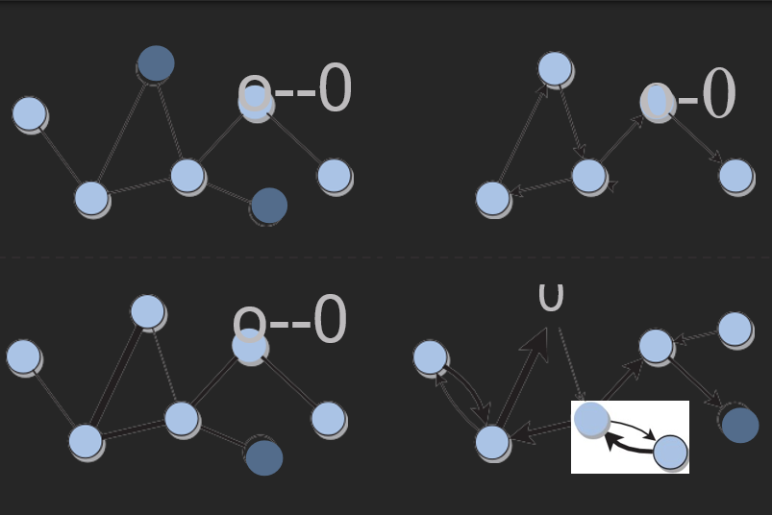
Undirected or directed networks
Graphical representations of undirected, directed, and weighted networks. The circles represent the nodes.
Pairs of adjacent nodes are connected by a line (link) or arrow (directed link).
Arrows indicate the direction of the links.
The thickness of a link represents its weight in weighted networks.

Slide 5
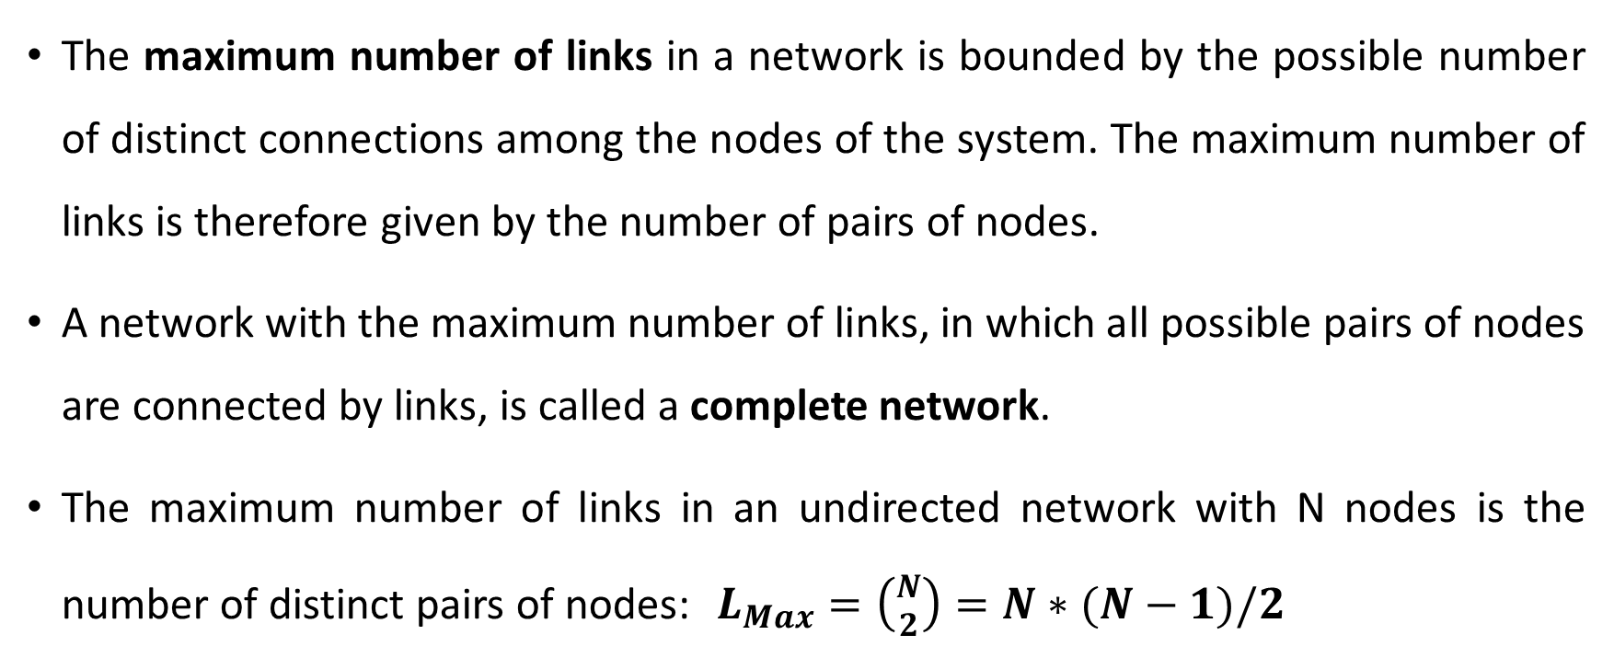
Density and Sparsity
The maximum number of links in a network is bounded by the possible number of distinct connections among the nodes of the system. The maximum number of links is there­fore given by the number of pairs of nodes.
A network with the maximum number of links, in which all possible pairs of nodes are connected by links, is called a complete network.
The maximum number of links in an undirected network with N nodes is the number of distinct pairs of nodes: $L_{Max}=\left({N \atop 2}\right)=N∗(N−1)/2$

Slide 6

Density and Sparsity (2)
The density of a network with N nodes and L links is ${d=L/L}_{Max}$.
In an undirected network:
$${d=L/L}_{Max}=\frac{2L}{N(N−1)}$$
In a directed network:
$${d=L/L}_{Max}=\frac{L}{N(N−1)}$$

Slide 7
Density and Sparsity (3)
In a complete network, d =1 by definition, since L = L_{max}.·
In a sparse network L << L_{max}, d<<1.
When a network grows very large, we can observe how the number of links increases as a function of the number of nodes.
The network is sparse if the number of links grows proportionally to the number of nodes L ~ N, or even slower. If instead the number of links grows faster, e.g. quadratically with network size (L ~ N²), then we say that the network is dense.
Path: a sequence of arcs in a network that can be traced continuously without retracing any arc.

Slide 8
Subnetworks
A subset of a network, which is itself a network is called a subnetwork (or subgraph).
A subnetwork is obtained by selecting a subset of the nodes and all of the links among these nodes.
A special type of subnetwork is the ego network of a node, which is the subnetwork consisting of the chosen node - called the ego - and its neighbors. Ego networks are often studied in social network analysis.

Slide 9
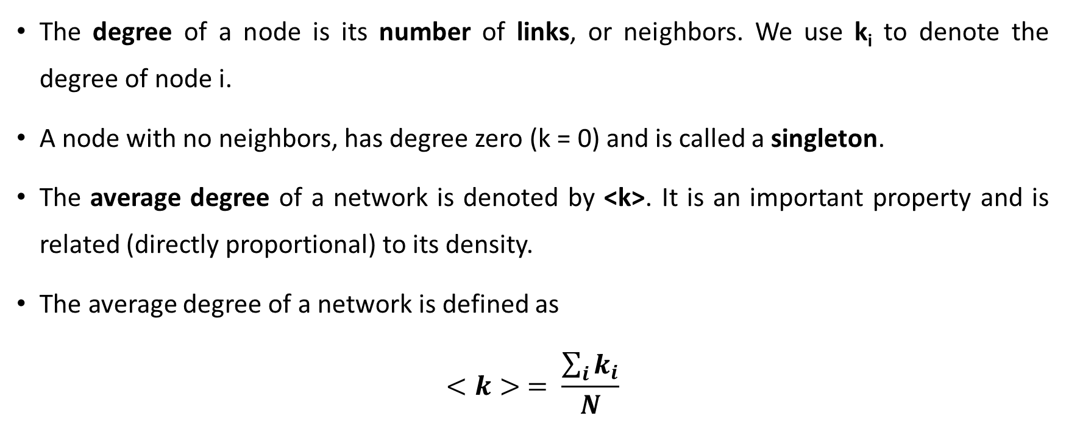
Degree
The degree of a node is its number of links, or neighbors. We use k_{i} to denote the degree of node i.
A node with no neighbors, has degree zero (k = 0) and is called a singleton.
The average degree of a network is denoted by <k>. It is an important property and is related (directly proportional) to its density.
The average degree of a network is defined as
$$<k> = \frac{\sum_{i}{k_{i}}}{N}$$

Slide 10
Network representations
To store/retrieve a network in/from a computer file or memory, we need a way to formally represent its nodes and links.
There are several possible network representations.
The sim­plest is the adjacency matrix, an N x N matrix in which each element represents the link between the nodes indexed by the corresponding row and column.

Slide 11
Handling Networks in Code
Network analysis and visualization tools, and libraries are available
to handle networks in many programming lan­guages, such as Gephi
NetworkX (networkx.github.io; https://networkx.org/), a Python package for the creation, manipulation, and study of the structure, dynamics, and function of networks.
NetworkX provides data structures, algorithms, measures, and generators for networks, as well as rudimentary visualization facilities.

Slide 12
Connectedness and Components
To relate network structure and function, it is useful to consider the connectedness of a network. The connectedness defines many properties of a network's physical structure.
The number of links in a network is bound by the number of nodes. This is an upper bound; there is no lower bound, as a network might have no links at all.
The higher the density, the greater the chances that the network is connected.
The fewer the links and the lower the density, the higher the chances that the network is disconnected.

Slide 13
Six Degrees of Separation
The name of the game Six Degrees of Kevin Bacon is inspired by the concept of six degrees of separation.
The idea is the same as that of a small world: any two people in the world are connected by a short chain of acquaintances. In other words, social networks have a short diameter and an even shorter average path length. The number "six" in the expression originated from Hungarian author Frigyes Karinthy in the 1920s, and some credit goes to Italian inventor Guglielmo Marconi as well for coming up with the same idea 20 years before, in the early 1900s. However, what made the "six degrees" expression famous was an experiment conducted by psychologist Stanley Milgram in the 1960s, which provided the first empirical evidence of small worlds.

Slide 14
Summary
A network is made up of two sets of elements: the nodes and links connecting pairs of nodes.
A subnetwork is a subset of the network including some of its nodes and all of the links among them.
In directed networks, links have a direction. There may be a link from node 1 to node 2, and not necessarily one from node 2 to node 1. In undirected networks, links are reciprocal.

Slide 15
Summary (2)
In weighted networks, links have associated weights that represent connection attributes like importance, similarity, distance, traffic, etc. In unweighted networks, all links are the same.
Multilayer networks have different types of nodes and links, divided into interconnected layers. If the nodes are the same in each layer, the multilayer network is called a multiplex.
The density of a network is the fraction of node pairs that are connected. A network is complete if all pairs of nodes are connected, so that the density is one. Most real networks are sparse, meaning that they have very small density.

Slide 16
Summary (3)
The degree of a node is the number of neighbors. In directed networks, nodes have in-degree and out-degree measuring the number of incoming and outgoing links, respectively. If the network is weighted, the strength of a node is the sum of the weights of its links. The nodes of weighted directed networks have in-strength and out-strength.
Adjacency lists and edge lists are efficient representations to store sparse networks.
NetworkX is a popular and convenient programming library to code networks in the Python language.

Slide 17
Homework
Consider a network with N nodes. Given a single link, what is the maximum number of nodes that link can connect? Given a single node, what is the maximum number of links that can connect to that node?
Consider a directed network of N nodes. Now consider the total in-degree (i.e. the sum of the in-degree over all nodes in the network). Compare this to the analogous total out-degree. Which of the following must hold true for any such network?
a. Total in-degree must be less than total out-degree
b. Total in-degree must be greater than total out-degree
c. Total in-degree must be equal to total out-degree
d. None of these hold true in all instances

Slide 18
Consider an undirected network with N nodes. What is the maximum number of links this network can have?
Consider a Twitter retweet network, where users are nodes and we want to show how many times a given user has retweeted another user. What link type best captures this relation?
a. Undirected, unweighted
b. Undirected, weighted
c. Directed, unweighted
d. Directed, weighted

Slide 19
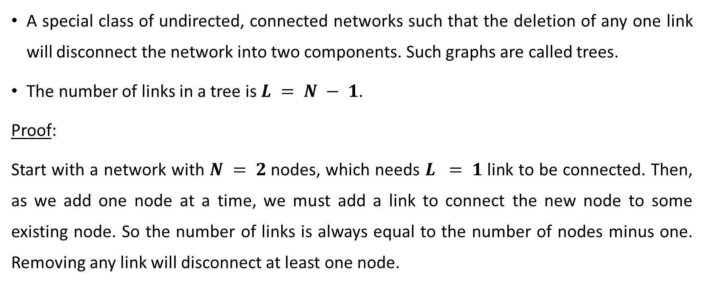
Trees
A special class of undirected, connected networks such that the deletion of any one link will disconnect the network into two components. Such graphs are called trees.
The number of links in a tree is $L = N − 1$.
Proof:
Start with a network with $N = 2$nodes, which needs $L = 1$link to be connected. Then, as we add one node at a time, we must add a link to connect the new node to some existing node. So the number of links is always equal to the number of nodes minus one. Removing any link will disconnect at least one node.

Slide 20
Trees (2)
Trees have no cycles.
Proof:
Trees cannot have cycles by contradiction: if a tree had a cycle, we could remove at least one link of the cycle without disconnecting it.
Therefore the network would not be a tree - a contradiction. Because there are no cycles, given any pair of nodes, there is only a single path connecting them.

Slide 21
Trees (3)
Trees are hierarchical.
You can pick any node in a tree and call it a root. Each node in a tree is connected to a parent node (toward the root) and to one or more children nodes (away from the root).
The exceptions are the root, which has no parent, and the so-called leaves of the tree, which have no children.

Slide 22
Hubs
hub: a center around which other things revolve or from which they radiate; a focus of activity, authority, commerce, transportation, etc.
If you have traveled on a plane, you have traversed an important network - the air transportation network. Nodes are airports and links are direct flights between them. While most air­ ports are rather small, a few major ones (e.g. Atlanta, Chicago, Denver) have daily flights to hundreds or even thousands of destinations.
Similarly, in social communities there are individuals who are much more visible and influential than others; and on the Web there are some very popular sites, such as google.com, while most sites are unknown to most.

Slide 23
Heterogeneity
Heteroge­neous networks present a wide variability in the properties and roles of their elements - nodes and/or links.
This reflects the diversity present in the complex systems described by networks. In air transportation networks, social networks, the Web, and many other net­ works, a clear source of heterogeneity is the degree of the nodes:
a few nodes have many connections (Atlanta, Google, Obama), while most nodes have few.

Slide 24
Centrality Measures
Degree: the degree of a node is the number of neighbors of that node.
In the example of the US airport network, the degree of a node (airport) is the number of other airports reachable from it via direct flights.
In a social network, the degree of a node (individual) is the number of social links con­necting the node to others. For instance, in a coauthorship network, the degree is the number of collaborators.High-degree nodes in social net­ works are people with many connections - whether because they are sociable, sought after, or simply eager to collaborate, these nodes seem to be important in some sense.
Therefore, the degree is a very natural measure of centrality in social networks.
The average degree of a network indicates how connected the nodes are on average. The average degree may not be representative of the actual distribution of degree values. This is the case when the nodes have heterogeneous degrees, as in many real-world networks.

Slide 25
Closeness
Another way to measure the centrality of a node is by determining how "close" it is to the other nodes.
This can be done by summing the distances from the node to all others.
If the distances are short on average, their sum is a small number and we say that the node has high centrality.
This leads to the definition of closeness centrality, which is simply the inverse of the sum of distances of a node from all others.

Slide 26
Betweenness
Many phenomena taking place in networks are based on diffusion processes.
Examples include the transmission of information across a social network, the traffic of goods through a port, and the spread of epidemics in the network of physical contacts between the individuals of a population.
This has suggested a third notion of centrality, called
betweenness: a node is the more central, the more often it is involved in these processes.

Slide 27
Robustness
A system is robust if the failure of some of its components does not affect its function. For instance, an airplane keeps flying if one of its engines stops working. In general, robustness depends on which components fail and on the extent of the damage.
How to define the robustness of a network?
Nodes can describe a broad variety of enti­ties, such as people, routers, proteins, neurons, websites, and airports. In such a high-level representation, it is not straightforward to define the failure of a node, which depends on the specific type of network. But if we assume that a node stops working somehow, we can ask how the structure and consequently the function of the network changes without that node and all of its links.

Slide 28
Standard robustness test for networks
The standard robustness test for networks consists of checking how the connectedness is affected as more and more nodes are removed, along with all of their adjacent links.
To estimate the amount of disruption following node removal, scholars compute the relative size of the giant component (i.e. the ratio of the number of nodes in the giant component to the number of nodes initially present in the network).

Slide 29
Standard robustness test for networks
Let us suppose that the initial network is connected.
In this case the giant component coincides with the whole network, so its relative size is one. If the removal of a subset of nodes does not break it into dis­connected pieces, the proportion of nodes in the giant component just decreases by the fraction of removed nodes.
If, however, the node removal breaks the network into two or more connected components, the size of the giant component may drop substantially.
As the fraction of removed nodes approaches one, the few remaining nodes are likely distributed among tiny components, so the proportion of nodes in the giant component is close to zero.

Slide 30
Resources
Menczer, Filippo, Santo Fortunato, and Clayton A. Davis. A first course in network science. Cambridge University Press, 2020.

Slide 31
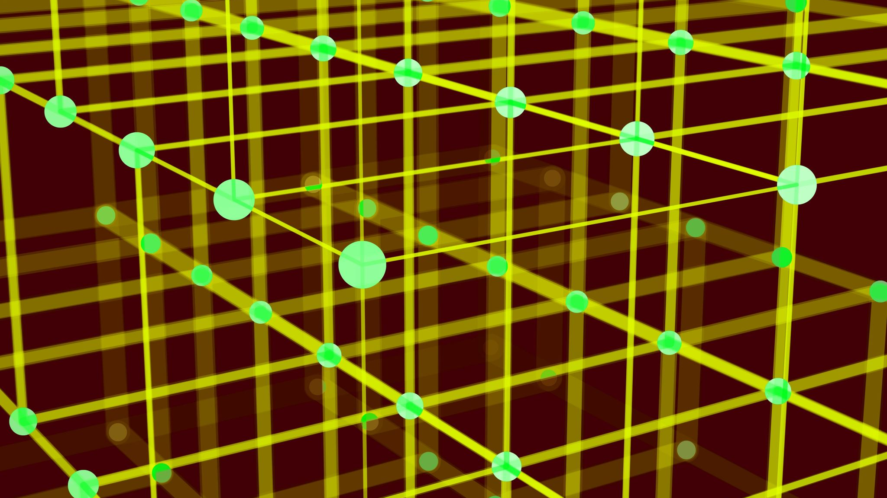
NETWORK SCIENCE
RANDOM NETWORKS

Slide 32
Erdős Number
The Hungarian mathematician Pál Erdős authored hundreds of research papers, many of them in collaboration with other mathematicians. His relentless collaborative approach to mathematics inspired the Erdős Number, which works like this:
Erdős’ Erdős number is 0. Erdős’ coauthors have Erdős number 1. Those who have written a paper with someone with Erdős number 1 have Erdős number 2, and so on.
If there is no chain of co-authorships connecting someone to Erdős, then that person’s Erdős number is infinite. Many famous scientists have low Erdős numbers: Albert Einstein has Erdős Number 2 and Richard Feynman has 3. The collaborators of Pál Erdős, as drawn in 1970 by Ronald Graham, one of Erdős’ close collaborators. As Erdős’ fame rose, this image has achieved an iconic status.

Slide 33
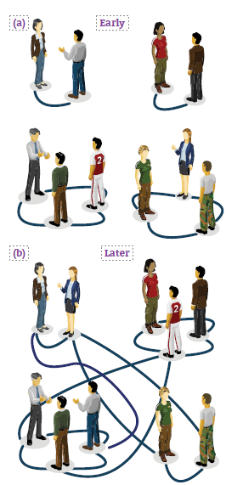
Imagine organizing a party for a hundred guests who initially do not know each other. Offer them wine and cheese and you will soon see them chatting in groups of two to three. Now mention to Mary, one of your guests, that the red wine in the unlabeled dark green bottles is a rare vintage, much better than the one with the fancy red label. If she shares this information only with her acquaintances, your expensive wine appears to be safe, as she only had time to meet a few others so far.
The guests will continue to mingle, however, creating subtle paths be-tween individuals that may still be strangers to each other. For example, while John has not yet met Mary, they have both met Mike, so there is an invisible path from John to Mary through Mike. As time goes on, the guests will be increasingly interwoven by such elusive links. With that the secret of the unlabeled bottle will pass from Mary to Mike and from Mike to John, escaping into a rapidly expanding group.

Slide 34
To be sure, when all guests had gotten to know each other, everyone would be pouring the superior wine. But if each encounter took only ten minutes, meeting all ninety-nine others would take about sixteen hours. Thus, you could reasonably hope that a few drops of your fine wine would be left for you to enjoy once the guests are gone.
Yet, you would be wrong. We show you why. We will see that the party maps into a classic model in network science called the random network model. And random network theory tells us that we do not have to wait until all individuals get to know each other for our expensive wine to be in danger. Rather, soon after each person meets at least one other guest, an invisible network will emerge that will allow the information to reach all of them. Hence in no time everyone will be enjoying the better wine.

Slide 35
THE RANDOM NETWORK MODEL
Network science aims to build models that reproduce the properties of real networks. Most networks we encounter do not have the comforting regularity of a crystal lattice or the predictable radial architecture of a spider web. Rather, at first inspection they look as if they were spun randomly. Random network theory embraces this apparent randomness by constructing and characterizing networks that are truly random.
From a modeling perspective a network is a relatively simple object, consisting of only nodes and links. The real challenge, however, is to decide where to place the links between the nodes so that we reproduce the complexity of a real system. In this respect the philosophy behind a random network is simple: We assume that this goal is best achieved by placing the links randomly between the nodes. That takes us to the definition of a random network:
A random network consists of N nodes where each node pair is connected with probability p.

Slide 36
THE RANDOM NETWORK MODE
To construct a random network we follow these steps:
1) Start with N isolated nodes.
2) Select a node pair and generate a random number between 0 and 1. If the number exceeds p, connect the selected node pair with a link, otherwise leave them disconnected.
3) Repeat step (2) for each of the N(N-1)/2 node pairs.
The network obtained after this procedure is called a random graph or a random network. Two mathematicians, Pál Erdős and Alfréd Rényi, have played an important role in understanding the properties of these networks. In their honor a random network is called the Erdős-Rényi network

Slide 37
Anatol Rapoport (1911-2007), a Russian immigrant to the United States, was the first to study random networks. Rapoport’s interests turned to mathematics after realizing that a successful career as a concert pianist would require a wealthy patron. He focused on mathematical biology at a time when mathematicians and biologists hard-ly spoke to each other. In a paper written with Ray Solomonoff in 1951, Rapoport demonstrated that if we increase the average degree of a network, we observe an abrupt transition from disconnected nodes to a graph with a giant component.
The study of random networks reached prominence thanks to the fundamental work of Pál Erdős and Alfréd Rényi. In a sequence of eight papers published between 1959 and 1968, they merged probability theory and combinatorics with graph theory, establishing random graph theory, a new branch of mathematics.
The random network model was independently introduced by Edgar Nelson Gilbert (1923-2013) the same year Erdős and Rényi published their first paper on the subject. Yet, the impact of Erdős and Rényi’s work is so overwhelming that they are rightly considered the founders of random graph theory.

Slide 38

NUMBER OF LINKS
Each random network generated with the same parameters N, p looks slightly different. Not only the detailed wiring diagram changes between realizations, but so does the number of links L. It is useful, therefore, to determine how many links we expect for a particular realization of a random network with fixed N and p.
The probability that a random network has exactly L links is the product of three terms:
1) The probability that L of the attempts to connect the N(N-1)/2 pairs of nodes have resulted in a link, which is p_{L}.
2) The probability that the remaining N(N-1)/2 - L attempts have not resulted in a link, which is (1-p)N(N-1)/2-L.
A combinational factor,
counting the number of different ways we can place L links among N(N-1)/2 node pairs.

Slide 39
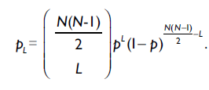

NUMBER OF LINKS
We can therefore write the probability that a particular realization of a random network has exactly L links as
It is a binomial distribution, the expected number of links in a random graph is

Slide 40

NUMBER OF LINKS (2)
Hence <L> is the product of the probability p that two nodes are connected and the number of pairs we attempt to connect, which is L_{max} = N(N - 1)/2
We obtain the average degree of a random network
Hence <k> is the product of the probability p that two nodes are connected and (N-1), which is the maximum number of links a node can have in a network of size N.
In summary the number of links in a random network varies between realizations. Its expected value is determined by N and p. If we increase p a random network becomes denser: The average number of links increase linearly from <L> = 0 to L_{max} and the average degree of a node increases from <k> = 0 to <k> = N-1.

Slide 41
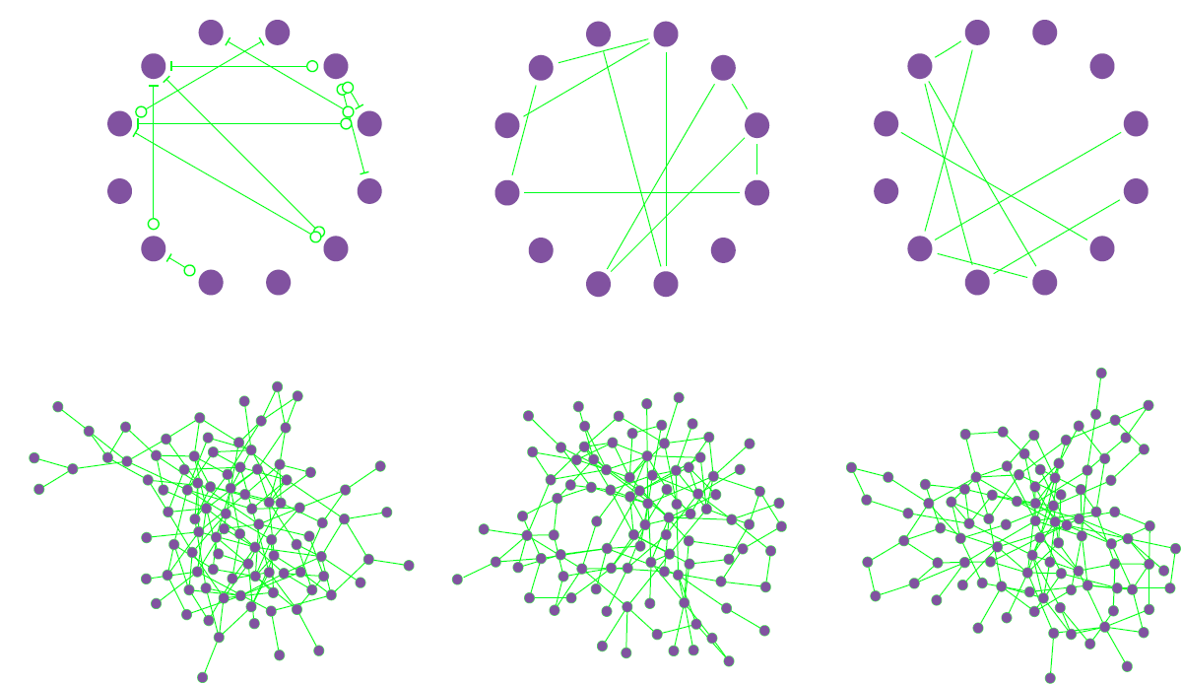
Random Networks are Truly Random
Top Row
Three realizations of a random network generated with the same parameters p=1/6 and N=12. Despite the identical parameters, the networks not only look different, but they have a different number of links as well (L=10, 10, 8).
Bottom Row
Three realizations of a random network with p=0.03 and N=100. Several nodes have degree k=0, shown as isolated nodes at the bottom.

Slide 42

DEGREE DISTRIBUTION
BINOMIAL DISTRIBUTION
In a random network the probability that node i has exactly k links is the product of three terms:
• The probability that k of its links are present, or p_{k}.
• The probability that the remaining (N-1-k) links are missing, or (1-p)N-1-k.
• The number of ways we can select k links from N- 1 potential links a node can have, or
Consequently the degree distribution of a random network follows the binomial distribution
In a given realization of a random network some nodes gain numerous links, while others acquire only a few or no links. These differences are captured by the degree distribution, p_{k}, which is the probability that a randomly chosen node has degree k. We derive p_{k} for a random network and discuss its properties.

Slide 43


POISSON DISTRIBUTION
Most real networks are sparse, meaning that for them <k> ≪ N. In this limit the degree distribution is well approximated by the Poisson distribution
which is often called, the degree distribution of a random network.
The binomial and the Poisson distribution describe the same quantity, hence they have similar properties.
• Both distributions have a peak around <k>. If we increase p the network becomes denser, increasing <k> and moving the peak to the right.
• The width of the distribution (dispersion) is also controlled by p or <k>. The denser the network, the wider is the distribution, hence the larger are the differences in the degrees.
BINOMIAL DISTRIBUTION
The shape of this distribution depends on the system size N and the probability p. The binomial distribution allows us to calculate the network’s average degree <k>, recovering, as well as its second moment <k²> and variance σ_{k}.

Slide 44

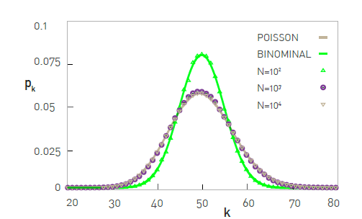
When we use the Poisson form, we need to keep in mind that:
• The exact result for the degree distribution is the binomial form, thus the Poisson
expression represents only an approximation valid in the <k> ≪ N limit.
As most networks of practical importance are sparse, this condition is typically satisfied.
• The advantage of the Poisson form is that key network characteristics, like <k>, <k²> and σ_{k} , have a much simpler form), depending on a single parameter, <k>.
• The Poisson distribution in does not explicitly depend on the number of nodes N. Therefore, predicts that the degree distribution of networks of different sizes but the same average degree <k> are indistinguishable from each other:
In summary, while the Poisson distribution is only an approximation to the degree distribution of a random network, thanks to its analytical simplicity, it is the preferred form for p_{k}.

Slide 45
REAL NETWORKS ARE NOT POISSON
As the degree of a node in a random network can vary between 0 and N-1, we must ask, how big are the differences between the node degrees in a particular realization of a random network?
That is, can high degree nodes coexist with small degree nodes? We address these questions by estimating the size of the largest and the smallest node in a random network.
Let us assume that the world’s social network is described by the random network model. This random society may not be as far fetched as it first sounds: There is significant randomness in whom we meet and whom we choose to become acquainted with.
Sociologists estimate that a typical person knows about 1,000 individuals on a first name basis, prompting us to assume that <k> ≈ 1,000. Using the results obtained so far about random networks, we arrive to a number of intriguing conclusions about a random society of N ≃ 7 x 10⁹ of individuals

Slide 46
REAL NETWORKS ARE NOT POISSON
• The most connected individual (the largest degree node) in a random society is expected to have k_{max} = 1,185 acquaintances.
• The degree of the least connected individual is k_{min} = 816, not that different from k_{max} or <k>.
• The dispersion of a random network is σ_{k} = <k>^{1/2} , which for <k> = 1,000 is σ_{k} = 31.62. This means that the number of friends a typical individual has is in the <k> ± σ_{k} range, or between 968 and 1,032, a rather narrow window.
Taken together, in a random society all individuals are expected to have a comparable number of friends. Hence if people are randomly connected to each other, we lack outliers: There are no highly popular individuals, and no one is left behind, having only a few friends. This suprising conclusion is a consequence of an important property of random networks: in a large random network the degree of most nodes is in the narrow vicinity of <k>.

Slide 47
REAL NETWORKS ARE NOT POISSON
This prediction blatantly conflicts with reality. Indeed, there is extensive evidence of individuals who have considerably more than 1,185 acquaintances. For example, US president Franklin Delano Roosevelt’s appointment book has about 22,000 names, individuals he met personally. Similarly, a study of the social network behind Facebook has documented numerous individuals with 5,000 Facebook friends, the maximum allowed by the social networking platform. To understand the origin of these discrepancies we must compare the degree distribution of real and random networks. We show the degree distribution of three real networks, together with the corresponding Poisson fit.

Slide 48
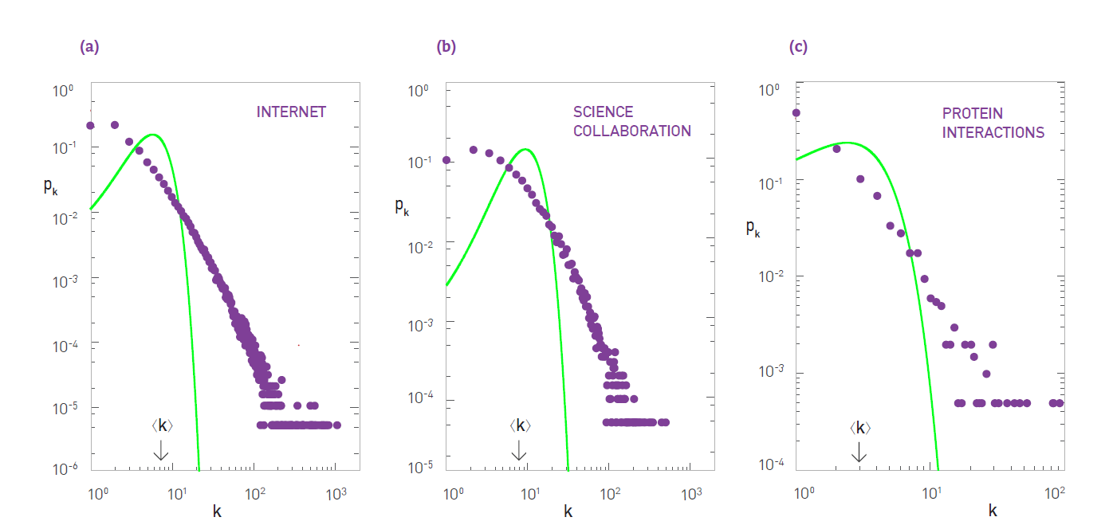
REAL NETWORKS ARE NOT POISSON (2)
The degree distribution of the (a) Internet, (b) science collaboration network, and (c) protein interaction network. The green line corresponds to the Poisson prediction, obtained by measuring <k> for the real network and then plotting.
The significant deviation between the data and the Poisson fit indicates that the random network model
underestimates the size and the frequency of the high degree nodes, as well as the number of low degree nodes. Instead the random network model predicts a larger number of nodes in the vicinity of <k> than seen in real networks.

Slide 49
THE EVOLUTION OF A RANDOM NETWORK
The cocktail party we encountered at the beginning of this chapter captures a dynamical process: Starting with N isolated nodes, the links are added gradually through random encounters between the guests. This corresponds to a gradual increase of p, with striking consequences on the network topology. To quantify this process, we first inspect how the size of the largest connected cluster within the network, N_{G}, varies with <k>. Two extreme cases are easy to understand:
• For p = 0 we have <k> = 0, hence all nodes are isolated. Therefore the largest component has size N_{G} = 1 and N_{G}/N→0 for large N.
• For p = 1 we have <k>= N-1, hence the network is a complete graph and all nodes belong to a single component. Therefore N_{G} = N and N_{G}/N = 1.

Slide 50

THE EVOLUTION OF A RANDOM NETWORK (2)
One would expect that the largest component grows gradually from N_{G} = 1 to N_{G} = N if <k> increases from 0 to N-1. Yet, this is not the case: N_{G}/N remains zero for small <k>, indicating the lack of a large cluster. Once <k> exceeds a critical value, N_{G}/N increases, signaling the rapid emergence of a large cluster that we call the giant component.
Erdős and Renyi in their classical 1959 paper predicted that the condition for the emergence of the giant component is
In other words, we have a giant component if and only if each node has on average more than one link.
The fact that we need at least one link per node to observe a giant component is not unexpected. Indeed, for a giant component to exist, each of its nodes must be linked to at least one other node. It is somewhat counterintuitive, however, that one link is sufficient for its emergence.

Slide 51

THE EVOLUTION OF A RANDOM NETWORK (3)
We can express <k> in terms of p using, obtaining
Therefore the larger a network, the smaller p is sufficient for the giant component.
The emergence of the giant component is only one of the transitions characterizing a random network as we change <k>. We can distinguish four topologically distinct regimes, each with its unique characteristics:

Slide 52

THE EVOLUTION OF A RANDOM NETWORK (4)
Subcritical Regime: 0 < <k> < 1 (p <1/N)
The critical point separates the regime where there is not yet a giant component (<k> < 1) from the regime where there is one (<k> > 1). At this point the relative size of the largest component is still zero. Indeed, the size of the largest component is N_{G} ~ N^{2/3}. Consequently N_{G} grows much slower than the network’s size, so its relative size decreases as N_{G}/N~ N ^{-1/3} in the N→∞ limit.
Note, however, that in absolute terms there is a significant jump in the size of the largest component at <k> = 1. For example, for a random network with N = 7 ×10⁹ nodes, comparable to the globe’s social network, for <k> < 1 the largest cluster is of the order of N_{G} ≃ lnN = ln (7 ×10⁹) ≃ 22.7. In contrast at <k> = 1 we expect N_{G} ~ N^{2/3} = (7 ×10⁹)^{2/3} ≃ 3 ×10⁶, a jump of about five orders of magnitude. Yet, both in the subcritical regime and at the critical point the largest component contains only a vanishing fraction of the total number of nodes in the network.
In summary, at the critical point most nodes are located in numerous small components. The power law form indicates that components of rather different sizes coexist. These numerous small components are mainly trees, while the giant component

Slide 53
THE EVOLUTION OF A RANDOM NETWORK (5)
Supercritical Regime: <k> > 1 (p > ￼1/N)
This regime has the most relevance to real systems, as for the first time we have a giant component that looks like a network. The giant component contains a finite fraction of the nodes. The further we move from the critical point, a larger fraction of nodes will belong to it.
In summary in the supercritical regime numerous isolated components coexist with the giant component.
These small components are trees, while the giant component contains loops and cycles. The supercritical regime lasts until all nodes are absorbed by the giant component.

Slide 54
THE EVOLUTION OF A RANDOM NETWORK (6)
Connected Regime: ‹k› > lnN (p > lnN / N)
For sufficiently large p the giant component absorbs all nodes and components, hence N_{G}≃ N. In the absence of isolated nodes the network becomes connected. The average degree at which this happens depends on N as <k> = lnN.
Note that when we enter the connected regime the network is still relatively sparse, as lnN / N → 0 for large N. The network turns into a complete graph only at <k> = N - 1.
In summary, the random network model predicts that the emergence of a network is not a smooth, gradual process: The isolated nodes and tiny components observed for small <k> collapse into a giant componentthrough a phase transition.
The discussion follows an empirical perspective, fruitful if we wish to compare a random network to real systems. A different perspective, with its own rich behavior, is offered by the mathematical literature.

Slide 55
REAL NETWORKS ARE SUPERCRITICAL
Two predictions of random network theory are of direct importance for real networks:
1) Once the average degree exceeds <k> = 1, a giant component should emerge that contains a finite fraction of all nodes. Hence only for <k> > 1 the nodes organize themselves into a recognizable network.
2) For <k> > lnN all components are absorbed by the giant component, resulting in a single connected network.
Do real networks satisfy the criteria for the existence of a giant component, i.e. <k> > 1? And will this giant component contain all nodes for <k> > lnN, or will we continue to see some disconnected nodes and components?

Slide 56
REAL NETWORKS ARE SUPERCRITICAL
We find that most real networks are in the supercritical regime.
Therefore these networks are expected to have a giant component, which is in agreement with the observations. Yet, this giant component should coexist with many disconnected components, a prediction that fails for several real networks. Note that these predictions should be valid only if real networks are accurately described by the Erdős-Rényi model, i.e. if real networks are random. In the followings, as we learn more about the structure of real networks, we will understand why real networks can stay connected despite failing the k > lnN criteria.

Slide 57
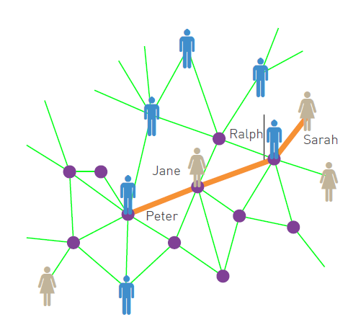
SMALL WORLDS
The small world phenomenon, also known as six degrees of separation, has long fascinated the general public. It states that if you choose any two individuals anywhere on Earth, you will find a path of at most six acquaintances between them (Figure on the right hand side) The fact that individuals who live in the same city are only a few handshakes from each other is by no means surprising.
The small world concept states, however, that even individuals who are on the opposite side of the globe can be connected to us via a few acquaintances.
In the language of network science the small world phenomenon implies that the distance between two randomly chosen nodes in a network is short. This statement raises two questions: What does short (or small) mean, i.e. short compared to what? How do we explain the existence of these short distances?

Slide 58
SMALL WORLDS (2)
Both questions are answered by a simple calculation. Consider a random network with average degree <k>. A node in this network has on average:
<k> nodes at distance one (d=1).
<k>2 nodes at distance two (d=2).
<k>3 nodes at distance three (d =3).
...￼
<k>d nodes at distance d.
For example, if <k> ≈ 1,000, which is the estimated number of acquaintences an individual has, we expect 106 individuals at distance two and about a billion, i.e. almost the whole earth’s population, at distance three from us.

Slide 59
SMALL WORLDS (3)
In summary the small world property has not only ignited the public’s imagination, but plays an important role in network science as well. The small world phenomena can be reasonably well understood in the context of the random network model: It is rooted in the fact that the number of nodes at distance d from a node increases exponentially with d.
In the coming chapters we will see that in real networks we encounter systematic deviations, forcing us to replace it with more accurate predictions. Yet the intuition offered by the random network model on the origin of the small world phenomenon remains valid.

Slide 60

CLUSTERING COEFFICIENT
The degree of a node contains no information about the relationship between a node's neighbors. Do they all know each other, or are they perhaps isolated from each other? The answer is provided by the local clustering coefficient C_{i}, that measures the density of links in node i’s immediate neighborhood: C_{i} = 0 means that there are no links between i’s neighbors C_{i} = 1 implies that each of the i’s neighbors link to each other.
To calculate C_{i} for a node in a random network we need to estimate the expected number of links L_{i} between the node’s ki neighbors. In a random network the probability that two of i’s neighbors link to each other is p. As there are k_{i}(k_{i} - 1)/2 possible links between the k_{i} neighbors of node i, the expected value of L_{i} is

Slide 61

CLUSTERING COEFFICIENT (2)
Thus the local clustering coefficient of a random network is
This Equation makes two predictions:
(1) For fixed <k>, the larger the network, the smaller is a node’s clustering coefficient. Consequently a node's local clustering coefficient C_{i} is expected to decrease as 1/N. Note that the network's average clustering coefficient, <C> also follows this formula.
(2) The local clustering coefficient of a node is independent of the node’s degree.
In summary, we find that the random network model does not capture the clustering of real networks. Instead real networks have a much higher clustering coefficient than expected for a random network of similar N and L. An extension of the random network model proposed by Watts and Strogatz addresses the coexistence of high <C> and the small world property. It fails to explain, however, why high-degree nodes have a smaller clustering coefficient than low-degree nodes

Slide 62
REAL NETWORKS ARE NOT RANDOM
Since its introduction in 1959 the random network model has dominated mathematical approaches to complex networks. The model suggests that the random-looking networks observed in complex systems should be described as purely random. With that it equated complexity with randomness.
We must therefore ask:
Do we really believe that real networks are random? The answer is clearly no.
As the interactions between our proteins are governed by the strict laws of biochemistry, for the cell to function its chemical architecture cannot be random. Similarly, in a random society an American student would be as likely to have among his friends Chinese factory workers than one of her classmates.
In reality we suspect the existence of a deep order behind most complex systems. That order must be reflected in the structure of the network that describes their architecture, resulting in systematic deviations from a pure random configuration.

Slide 63
REAL NETWORKS ARE NOT RANDOM (2)
The degree to which random networks describe, or fail to describe, real systems, must not be decided by epistemological arguments, but by a systematic quantitative comparison. We can do this, taking advantage of the fact that random network theory makes a number of quantitative predictions:
Distribution
A random network has a binomial distribution, well approximated by a Poisson distribution in the k « N limit. Yet, as shown, the Poisson distribution fails to capture the degree distribution of real networks. In real systems we have more highly connected nodes than the random network model could account for.
Connectedness
Random network theory predicts that for <k> > 1 we should observe a giant component, a condition satisfied by all networks we examined. Most networks, however, do not satisfy the <k> > ln N condition, implying that they should be broken into isolated clusters. Some networks are indeed fragmented, most are not.

Slide 64
REAL NETWORKS ARE NOT RANDOM (3)
Average Path Length
Random network theory predicts that the average path length follows, a prediction that offers a reasonable approximation for the observed path lengths. Hence the random network model can account for the emergence of small world phenomena.
Clustering Coefficient
In a random network the local clustering coefficient is independent of the node’s degree and <C> depends on the system size as 1/N. In contrast, measurements indicate that for real networks C(k) decreases with the node degrees and is largely independent of the system size.
Taken together, it appears that the small world phenomena is the only property reasonably explained by the random network model. All other network characteristics, from the degree distribution to the clustering coefficient, are significantly different in real networks.

Slide 65
THE SCALE-FREE PROPERTY
World Wide Web:
a network whose nodes are documents and the links are the uniform resource locators (URLs) that allow us to “surf” with a click from one web document to the other.
Importance of the World Wide Web:
WWW played in the development of network theory: it facilitated the discovery of a number of fundamental network characteristics and became a standard testbed for most network measures.
Network Science, 10/19/2023

Slide 66
CRAWLER
A software called a crawler can be used to map out the Web’s wiring diagram.
A crawler can start from any web document, identifying the links (URLs) on it. Next it downloads the documents these links point to and identifies the links on these documents, and so on. This process iteratively returns a local map of the Web. Search engines like Google or Bing operate crawlers to find and index new documents and to maintain a detailed map of the WWW.
The purpose of the map was to compare the properties of the Web graph to the random network model. Indeed, in 1998 there were reasons to believe that the WWW could be well approximated by a random network.
Network Science, 10/19/2023

Slide 67
Differences between real and random network
In a random network highly connected nodes, or hubs, are effectively forbidden.
In contrast, in the Figure numerous small-degree nodes coexist with a few hubs, nodes with an exceptionally large number of links.
Network Science, 10/19/2023

Slide 68
DEGREE DISTRIBUTION OF REAL NETWORKS
Hubs are not unique to the Web, but we encounter them in most real networks. They represent a signature of a deeper organizing principle that we call the scale-free property.
No matter what network property we are interested in, from communities to spreading processes, it must be inspected in the light of the network’s degree distribution.
Network Science, 10/19/2023

Slide 69
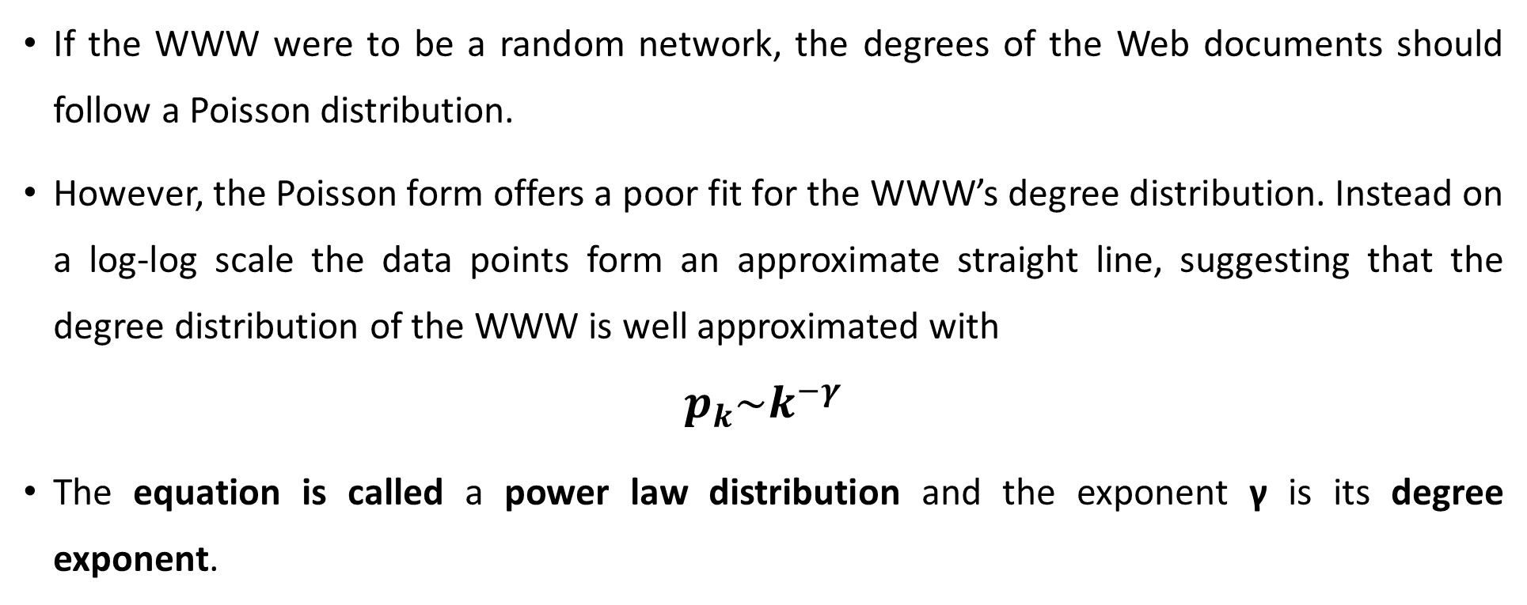
POWER LAWS AND SCALE-FREE NETWORKS
If the WWW were to be a random network, the degrees of the Web documents should follow a Poisson distribution.
However, the Poisson form offers a poor fit for the WWW’s degree distribution. Instead on a log-log scale the data points form an approximate straight line, suggesting that the degree distribution of the WWW is well approximated with
$$p_{k}\sim k^{−γ}$$
The equation is called a power law distribution and the exponent γ is its degree exponent.
Network Science, 10/19/2023

Slide 70
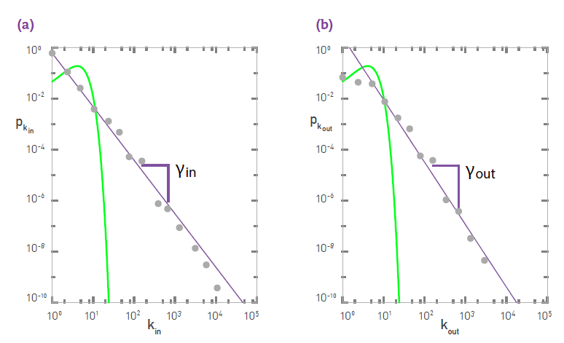
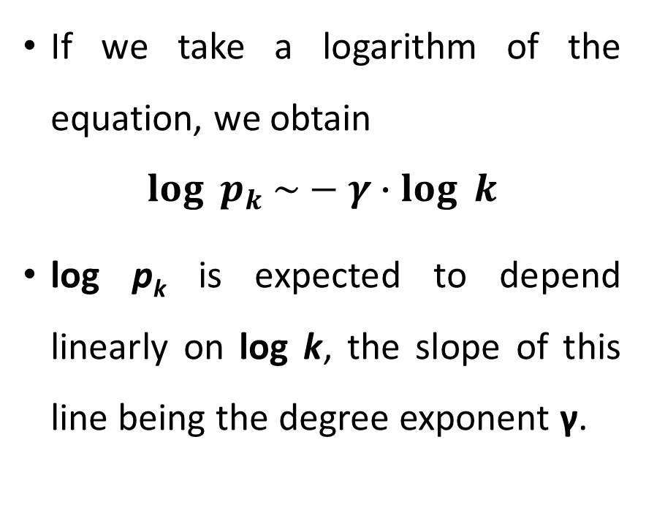
Logarithm plot
If we take a logarithm of the equation, we obtain
$$\log_{ }{p_{k} \sim }−{γ∙log}_{ }{k}$$
log p_{k} is expected to depend linearly on log k, the slope of this line being the degree exponent γ.
Network Science, 10/19/2023

Slide 71
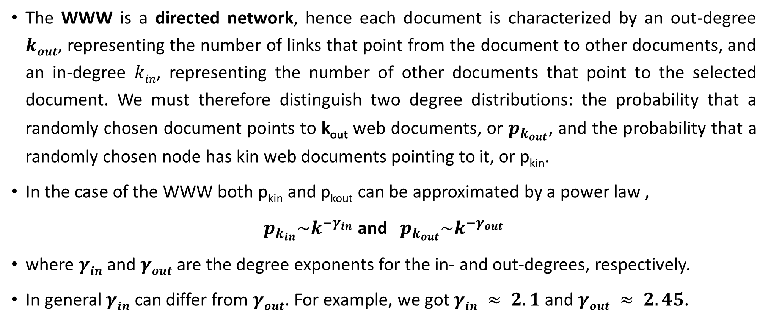
in-degree and out-degree
The WWW is a directed network, hence each document is characterized by an out-degree $kout$, representing the number of links that point from the document to other documents, and an in-degree $kin$, representing the number of other documents that point to the selected document. We must therefore distinguish two degree distributions: the probability that a randomly chosen document points to k_{out} web documents, or $p_{k_{out}}$, and the probability that a randomly chosen node has kin web documents pointing to it, or p_{kin}.
In the case of the WWW both p_{kin} and p_{kout} can be approximated by a power law ,
$p_{k_{in}}\sim k^{{−γ}_{in}}$ and $p_{k_{out}}\sim k^{{−γ}_{out}}$
where $γin$ and $γout$ are the degree exponents for the in- and out-degrees, respectively.
In general $γin$ can differ from $γout$. For example, we got $γin ≈ 2.1$ and $γout ≈ 2.45$.
Network Science, 10/19/2023

Slide 72
Definition of the scale-freee network
The empirical results document the existence of a network whose degree distribution is quite different from the Poisson distribution characterizing random networks.
We will call such networks scale-free, defined as:
A scale-free network is a network whose degree distribution follows a power law.
Network Science, 10/19/2023

Slide 73
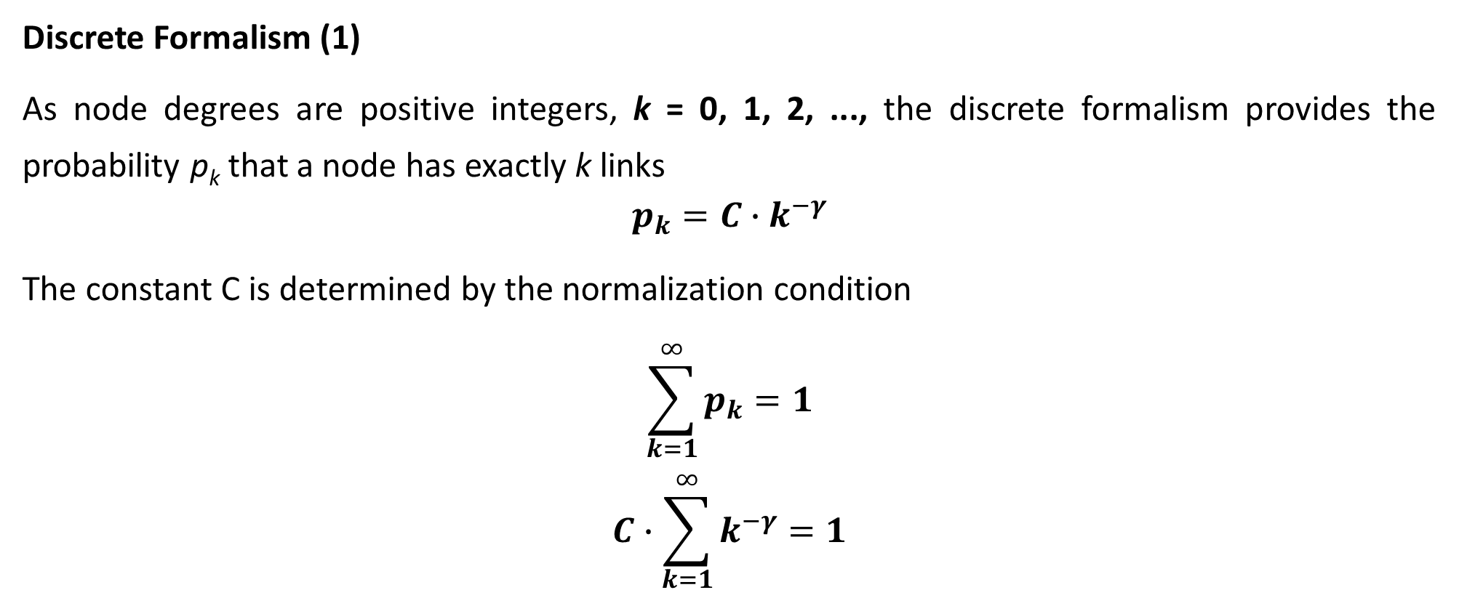
Discrete and the continuum formalisms of power-law distribution
Discrete Formalism (1)
As node degrees are positive integers, k = 0, 1, 2, ..., the discrete formalism provides the probability p_{k} that a node has exactly k links
$$p_{k}=C∙k^{−γ}$$
The constant C is determined by the normalization condition
$$\sum_{k=1}^{∞}{p_{k}=1}$$
$$C∙\sum_{k=1}^{∞}{k^{−γ}=1}$$
Network Science, 10/19/2023

Slide 74

Discrete Formalism (2)
$$C=\frac{1}{\sum_{k=1}^{∞}{k^{−γ}}}=\frac{1}{ξ\left(γ\right)}$$
where $ξ\left(γ\right)$is the Riemann-zeta function. Thus for $k > 0$ the discrete power-law distribution has the form
$$p_{k}=\frac{k^{−γ}}{ξ\left(γ\right)}$$
Network Science, 10/19/2023

Slide 75
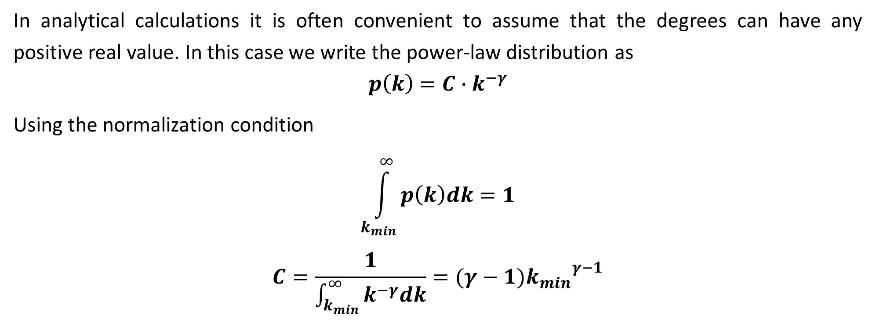
Continuum formalism
In analytical calculations it is often convenient to assume that the degrees can have any positive real value. In this case we write the power-law distribution as
$$p\left(k\right)=C∙k^{−γ}$$
Using the normalization condition
$$\int_{k_{min}}^{∞}{p\left(k\right)dk=1}$$
$$C=\frac{1}{\int_{k_{min}}^{∞}{k^{−γ}dk}}=(γ−1){k_{min}}^{γ−1}$$
Network Science, 10/19/2023

Slide 76
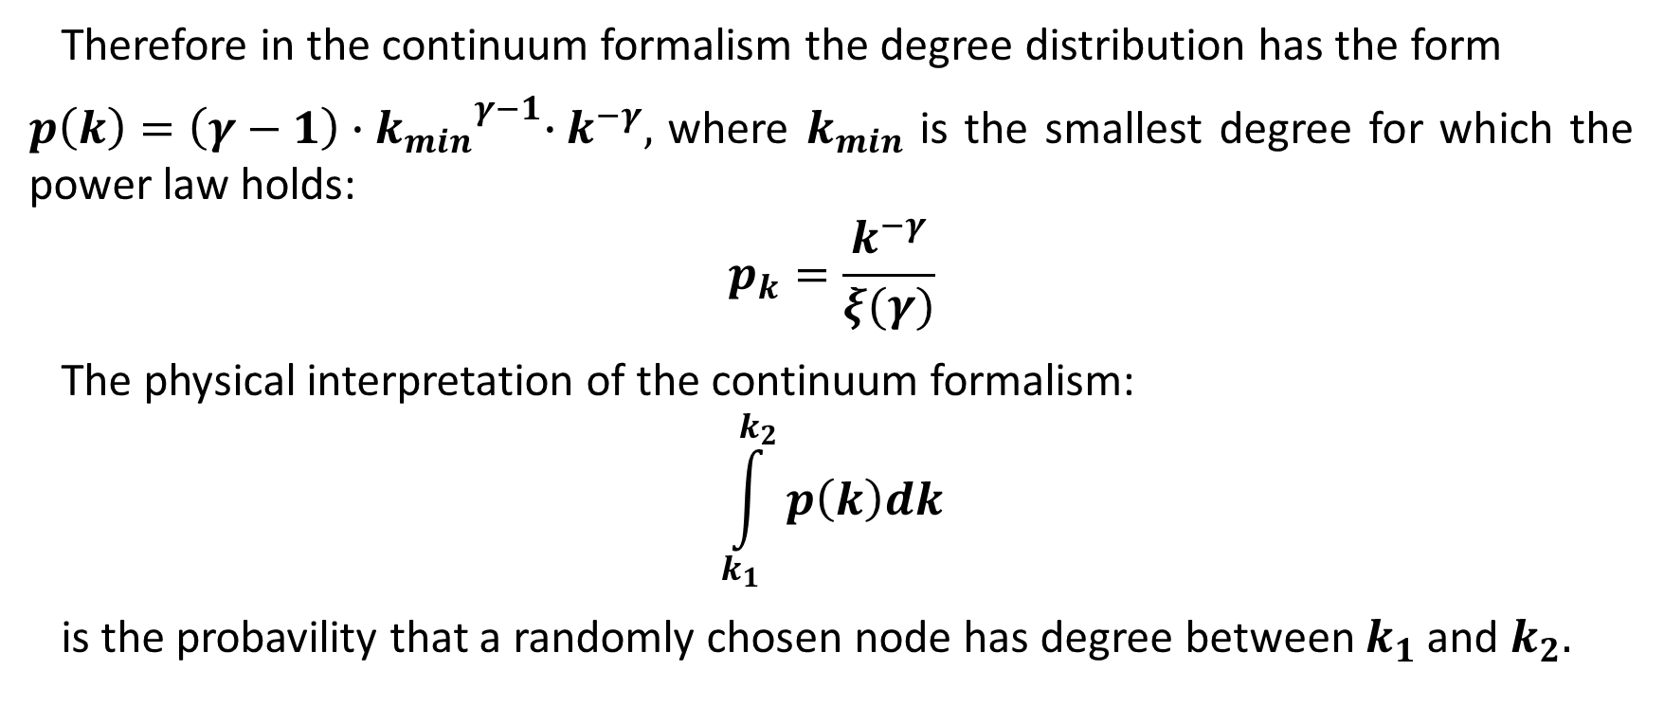
Continuum formalism (2)
Therefore in the continuum formalism the degree distribution has the form
$p\left(k\right)=\left(γ−1\right){{∙k}_{min}}^{γ−1}∙k^{−γ},$ where $k_{min}$ is the smallest degree for which the power law holds:
$$p_{k}=\frac{k^{−γ}}{ξ(γ)}$$
The physical interpretation of the continuum formalism:
$$\int_{k_{1}}^{k_{2}}{p\left(k\right)dk}$$
is the probavility that a randomly chosen node has degree between $k_{1}$ and $k_{2}.$
Network Science, 10/19/2023

Slide 77
In summary, networks whose degree distribution follows a power law are called scale-free networks. If a network is directed, the scale-free property applies separately to the in- and out-degrees. To mathematically study the properties of scale-free networks, we can use either the discrete or the continuum formalism. The scale-free property is independent of the formalism we use.

